Slide 1
Lecture 4: ‘Does size matter?’: The effects of anabolic steroids and growth hormone on exercise training and performance.

Slide 2
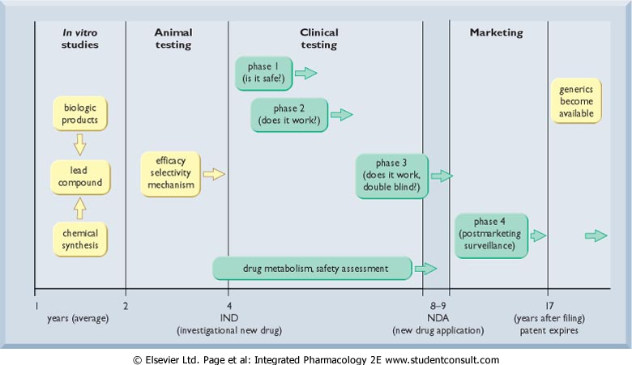
Clinical Trials

Slide 3
Clinical testing
Phase 1 (volunteers)
Phase 2 (patients)
Phase 3 (large scale multi-centre)
Phase 4 (post registration monitoring)
Phases can also be defined by the information you are trying to get out of the testing.

Slide 4
Volunteer studies (phase I trials)
pharmacologists & employees (15-30 in number)
ethical approval
healthy
informed consent
full resuscitation + medical backup
monitor
single and repeat doses
increase dose levels

Slide 5
Volunteer studies (phase I trials)
OBJECTIVES
metabolic and excretory pathways
variability between individuals; effect of route of administration; bioavailability.
tolerated dose range
indication of therapeutic effects
indication of side-effects

Slide 6
Patient studies (phase 2 trials)
150-350 ill people; informed consent
needs license
maximum monitoring; full resuscitation
often patients where other treatment failed
OBJECTIVES:
indication for use; type of patient; severity of disease;
dose range, schedule and increment; pharmacokinetic studies in ill people; nature of side effects and severity;
effects in special groups.

Slide 7

Patient studies (phase 3 trials)
1500-3500 ill patients
multicentre
more certain data for the objectives of phase 2 studies
interactions between drugs start to become measurable in the larger population
sub-groups start to be established
special features and problems show up
May exclude certain risk groups
Depressed patient treated with cannabinoid receptor blocker for obesity.
Older patients treated with a COX-2 inhibitor.

Slide 8

Could TGN1412 tragedy have been be avoided?
Six healthy volunteers who took TGN1412 for the first human trial in London on 13 March 2006 showed serious toxic reactions with collapse and loss of consciousness with multi-organ failure and were admitted to ICU.
Biological Drugs need new forms of testing.

Slide 9
Pharmacologic Agents
IOC-banned substance categories
Stimulants
Narcotic analgesics
Androgenic-anabolic steroids
β-Blockers
Diuretics
Peptide hormones and analogs
Substances that alter urine sample integrity

Slide 10
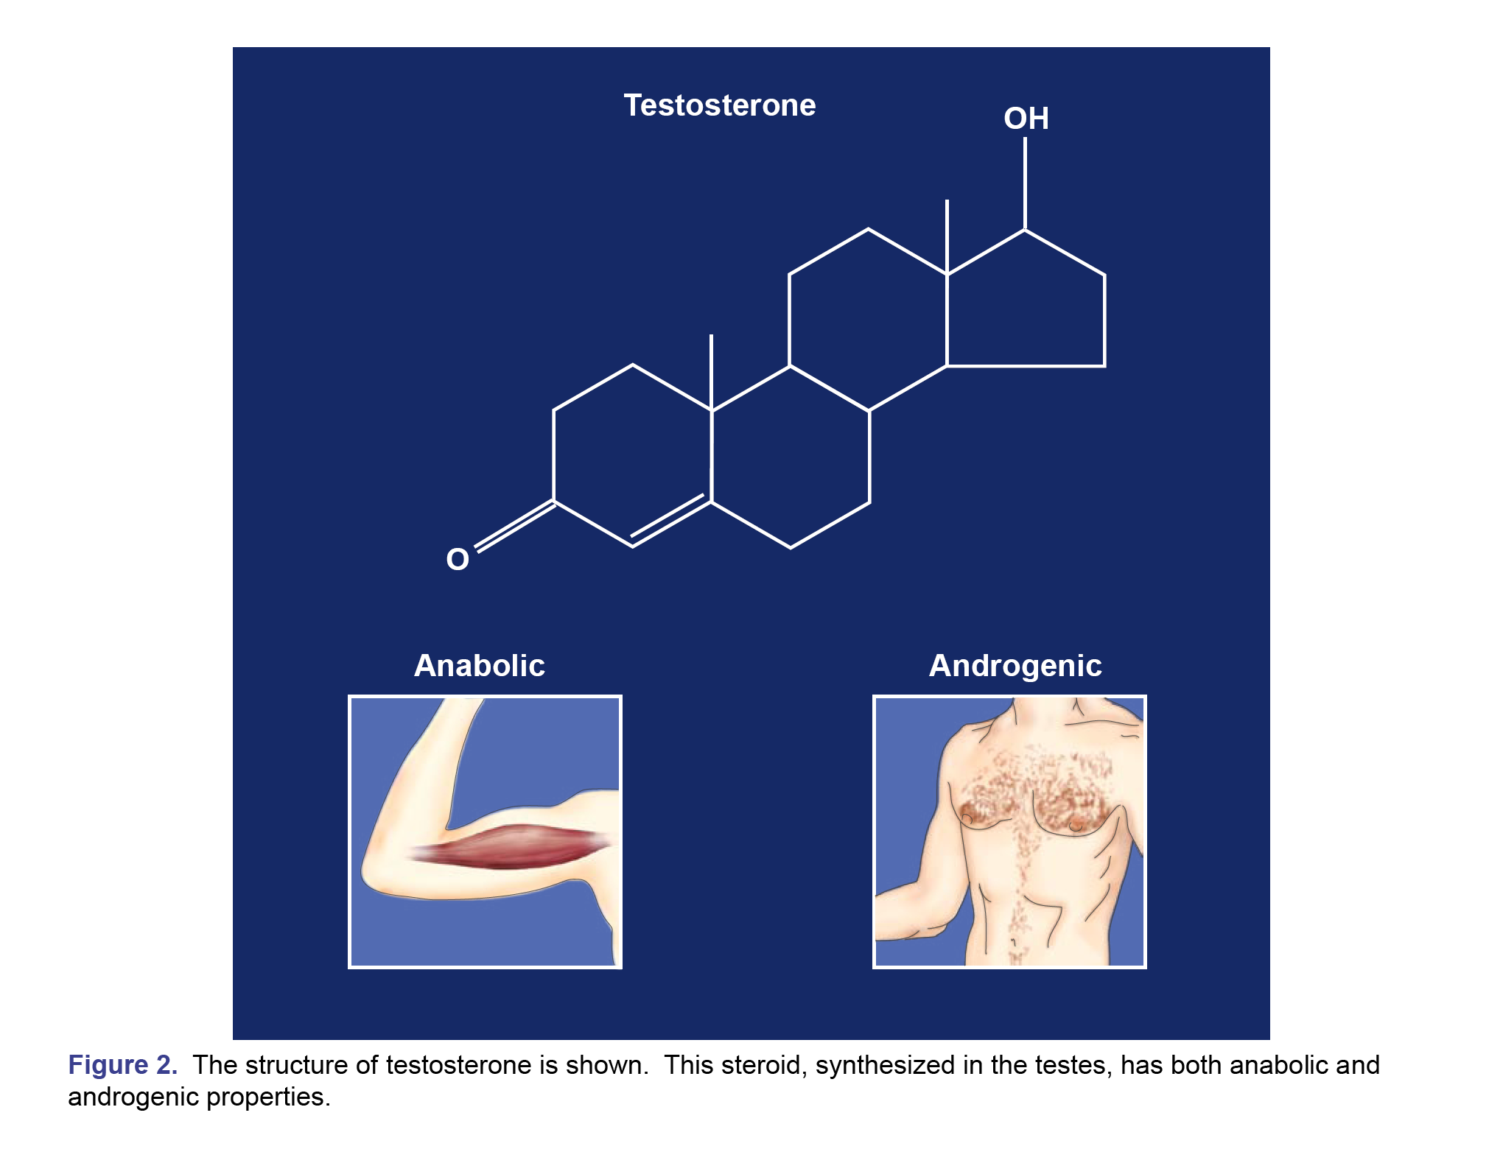

Anabolic = Increase in muscle and bone
Androgenic = reproductive and sexual characteristics (e.g. hair, voice)

Slide 11
How do anabolic steroids work?
Like the natural steroids, the synthetic steroids bind to steroid receptors cell.
The steroid and the receptor are carried to the nucleus and instruct the cell to transcribe mRNA.
mRNA increases protein synthesis and causes muscle growth.
In bone cells- it increases bone size.

Slide 12
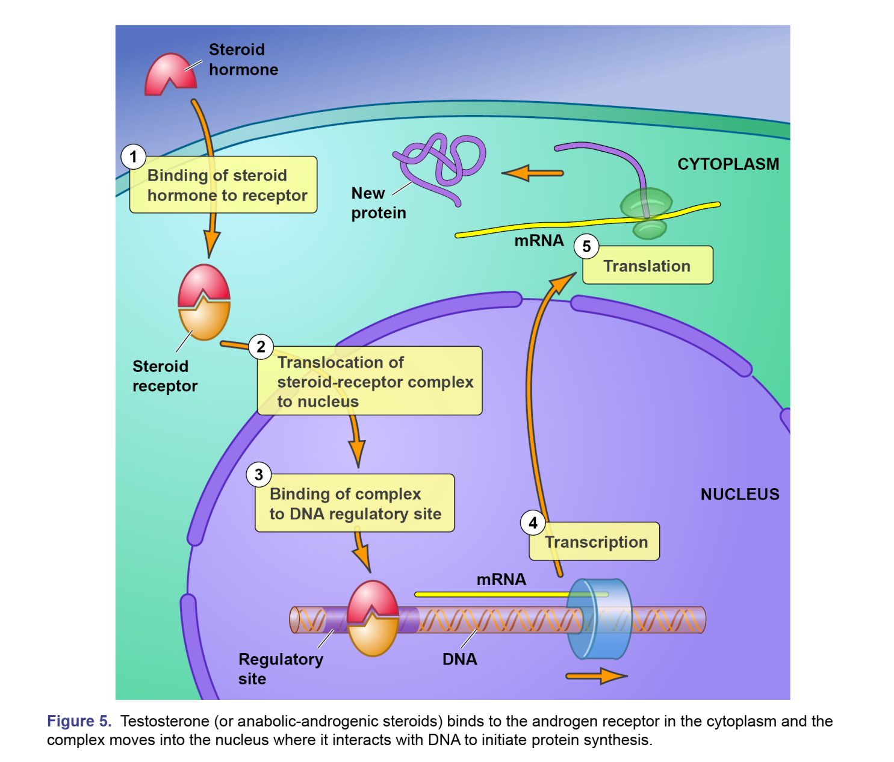

Slide 13
Anabolic Steroids
Drug with a considerable following
Becoming increasingly popular with more than just strength athletes
Effectiveness
Dosage is an important factor.
Training volume accompanies use.

Slide 14
Abuse of Anabolic Steroids
Stacking
Combining multiple steroid preparations in oral and injectable form
Pyramiding
Progressively increasing the dosage
Drug quantity used sometimes exceeds
the medical dose by 40 fold

Slide 15
Anabolic Steroids
90% of professional bodybuilders use Steroids
Side effects and medical risks
Cystic acne, “roid rage,” increased plasma lipoproteins.
In males: testicular atrophy.
In females: squaring of the jaw, lowering of voice.

Slide 16
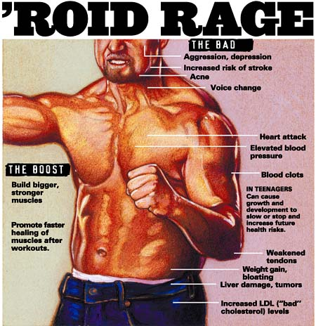

Slide 17
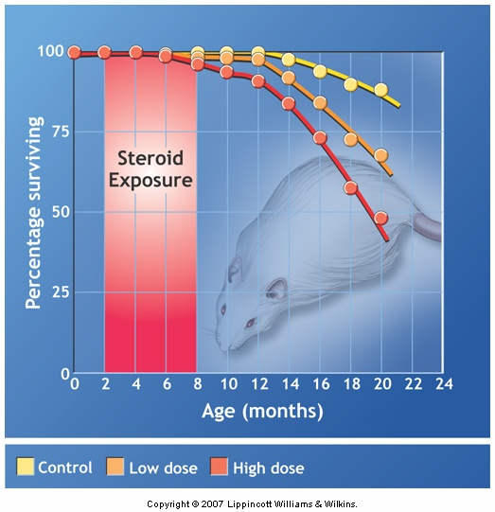
Life shortening effects of steroids

Slide 18
Anabolic Steroids
Not rigidly controlled, double-blind trials that are placebo controlled.
Trials have used different doses from those used by athletes.
High doses used by athletes would be prohibited in clinical trials by safely legislation.
Difficult to accurately assess a realistic profile for use and to assess the dangers of side-effects

Slide 19
DHEA: A Worrisome Trend?
DHEA
Steroid hormone produced by the adrenal glands
Claims for DHEA
Testosterone booster
Bolsters immune system
Preserves youth
Decreases fatigue and joint pain
Slows aging
Invigorates sex life

Slide 20
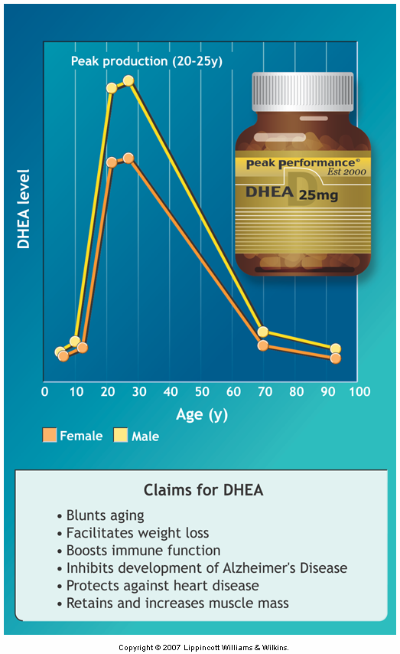
DHEA levels decrease with age.

Slide 21
DHEA: A Worrisome Trend?
An unregulated compound with uncertain safety.
Elevated plasma DHEA might stimulate the growth of otherwise dormant prostate gland tumors.

Slide 22
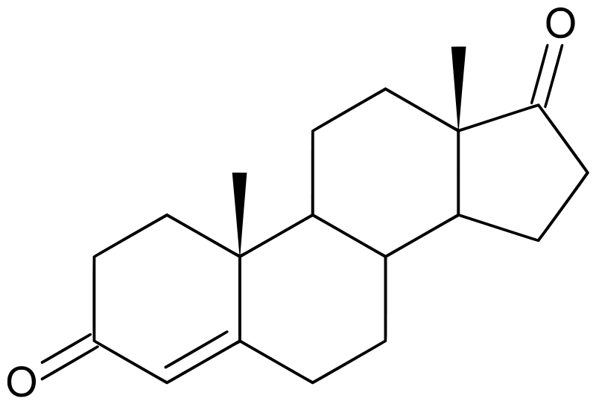
Androstenedione: nutritional supplement or harmful drug?
Androstenedione is the common precursor of male and female sex hormones. Some androstenedione is also secreted into the plasma, and may be converted in peripheral tissues to testosterone and estrogens.
Over-the-counter ‘nutritional supplement’
Banned by IOC.

Slide 23
Androstenedione: nutritional supplement or harmful drug?
Claims
Stimulates production of endogenous testosterone
Enables one to train harder
Increases muscle mass
Rapidly repairs tissue injury
Research shows no effect of supplementation on basal serum testosterone or any training response on muscle size and strength.

Slide 24
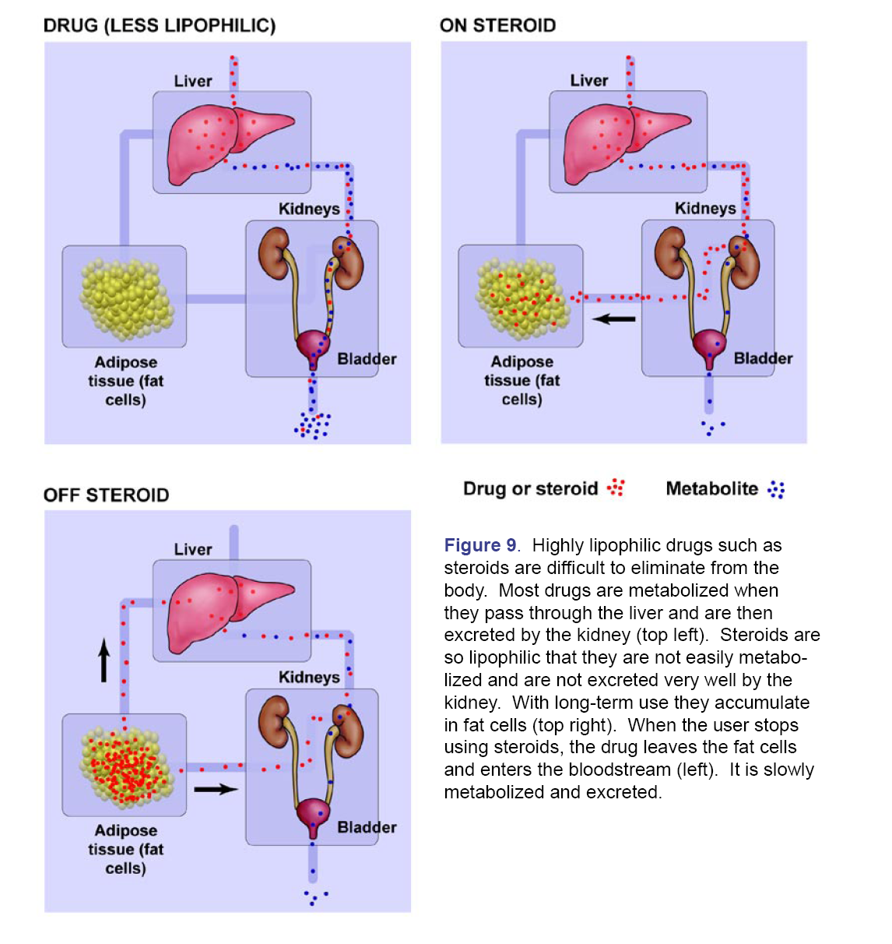
Steroids can be detected in the urine weeks after use is stopped.

Slide 25
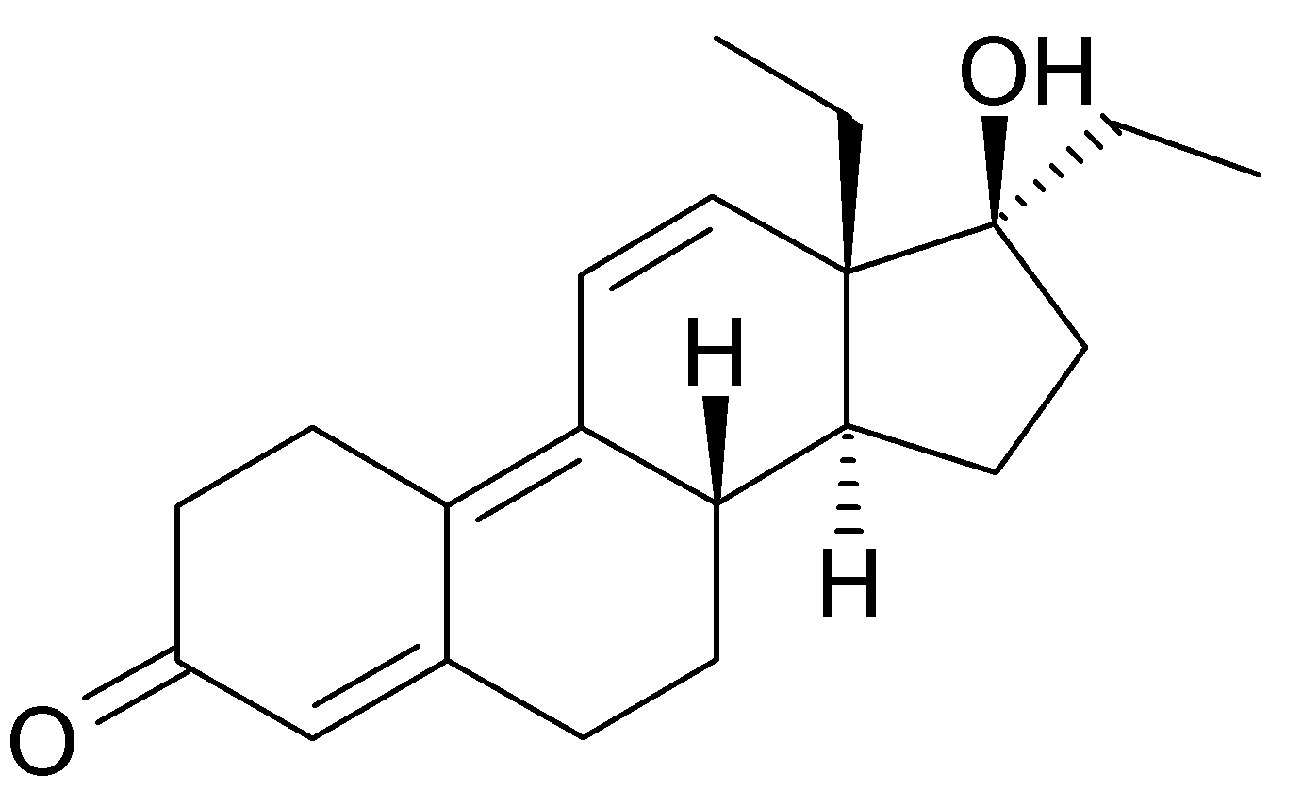
Tetrahydrogestrinone
Often referred to as THG
Referred to as a designer drug
Very potent activator of androgen receptors
10 times more potent than Nandrolone

Slide 26

Tetrahydrogestrinone
Often referred to The Clear
The ‘drug was undetectable or ‘invisible’
Used by Marion Jones and Dwain Chambers
UCLA Olympic Analytical Lab
Don Catlin developed a test for THG
Chicago Tribune named him Sportsman of the Year!

Slide 27
Growth Hormone
Genetic engineering comes to sports
Human growth hormone
Produced in the pituitary gland
Stimulates bone and cartilage growth
Enhances fatty acid oxidation
Reduces glucose and amino acid breakdown
Excess GH may result in
Gigantism (overgrowth of the entire body)
Acromegaly (enlarged facial features)
No unanimity among researchers as to effectiveness.
Cannot be detected in urine because naturally occurring.

Slide 28
Erythropoietin (EPO)
Erythropoietin (EPO) is a peptide hormone that is produced naturally by the human body. EPO is released from the kidneys and acts on the bone marrow to stimulate red blood cell production.
An increase in red blood cells improves the amount of oxygen that the blood can carry to the body’s muscles. It may also increase the body’s capacity to buffer lactic acid.

Slide 29
Hormonal Blood Boosting
Erythropoietin (EPO)
Synthetic version of a hormone produced by the kidneys
May increase RBC number by 12%
Unconventional or nonmedical administration may create >60% increase.
Increases blood viscosity.
Increases risk of stroke, heart attack, heart failure, pulmonary edema

Slide 30
EPO Abuse: WADA
‘While proper use of EPO has an enormous therapeutic benefit in the treatment of anaemia related to cancer or kidney disease, its misuse can lead to serious health risks for athletes who use this substance simply to gain a competitive edge. It is well known that EPO, by thickening the blood, leads to an increased risk of several deadly diseases, such as heart disease, stroke, and cerebral or pulmonary embolism. The misuse of recombinant human EPO may also lead to autoimmune diseases with serious health consequences.’
EPO use is prevalent in cycling – just ask Lance Armstrong.
Has allegedly contributed to ~20 deaths (heart attack) among competitive cyclists.

Slide 31
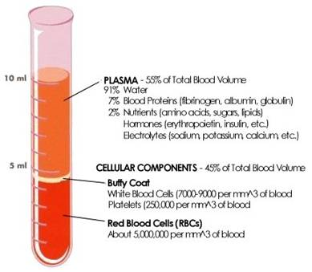
Detection of EPO
Cannot be detected in urine, blood hematocit acts as a marker.
Hematocrit is the proportion of blood volume that is occupied by red blood cells.
Hematocrit set at 50% for males and 47% for females.

